Slide 1
Fluid flow
Fluid dynamic

Slide 2
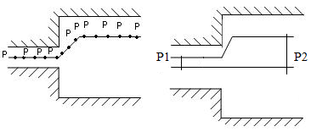
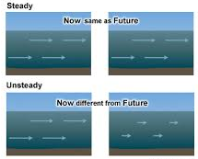
Methods of Describing Fluid Motion
The fluid motion is described by two methods. They are
Lagrangian Method,
(ii) Eulerian Method.
Types of Fluid Flow
Fluids may be classified
as follows:
Steady and unsteady flows
.

Slide 3
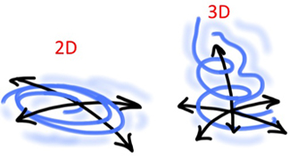
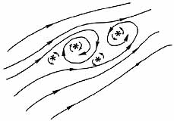
2. Uniform and non-uniform flows
3. One, two and three
dimensional flows
4. Rotational and irrotational flows
5. Laminar and turbulent flows
6. Compressible and incompressible flows

Slide 4
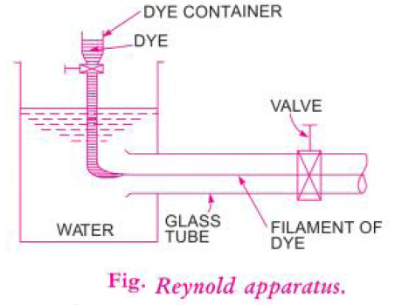
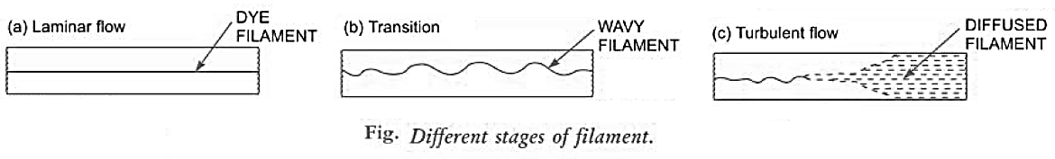
Reynolds experiment

Slide 5

Reynolds number
Reynolds number is a dimensionless number, defined as:
Re = (Inertia forces/Viscous forces). Or,

Slide 6
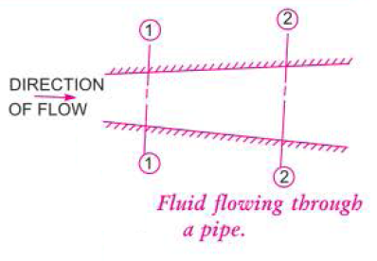
Continuity Equation
The equation based on the principle of conservation of mass is called continuity equation.
If the fluid is incompressible, then
Where Q is the discharge (the volume of fluid flowing across the section per second)

